Slide 1


Trusted Digital Web: 8-Layer Architecture Reference Model (TDW-ARM) 0.23 – July 2021
Michael Herman, Trusted Digital Web, Hyperonomy Digital Identity Lab, Parallelspace Corporation
https://github.com/mwherman2000/TrustedDigitalWeb
Trusted Digital Assistant
Abstractions
Ledgers and Subledgers
Smart Wallet
Smart Credentials, Workflows, Payments
Key Ring
Asymmetric Key Pairs
Master Secrets
Symmetric Keys
User Abstractions
Platform Services
Client TRA Helpers
.NET Callable API
Client KMA Helpers
.NET Callable API
Verifiable Data Registry
Verifiable Data Agent (VDA)
TRA “Trinity” Microservices
KMA “Trinity” Microservices
Services
Trusted Resource Agent (TRA)
Key Pair Management Agent
(KMA)
Trust Levels
Unsigned
Hashed Thumbprint
Signed Hash Signature
Verifiable
KMA MKM Helpers
.NET Callable API
Ledger Account Registry (LAR)
Smart Contract Registry (SCR)
Services VDA Helpers
.NET Callable API
UIR, SEPR, Revocation List
Platform Services
Platform Capabilities
VDA “Trinity” Microservices
“Trinity” Schema Language
Automated Class Generator for Serializable Objects & Messages
Request/Response Protocols, Public and Private Microservices, Microservice Endpoint Handlers
Distributed Workflow Execution
LINQ Query Language supported
Stratis VDR Helpers
.NET Callable API
Master Key Manager (MKM)
Stratis VDR Driver
(REST/HTTP)
Platform
Stratis VDR Smart Contract Universal Identifier Registry (UIR)
Service Endpoint Registry (SEPR)
Revocation List (RL)
RSA 2048-bit Asymmetric Key Pairs
Platform Capabilities
Foundation Features
“Trinity” Graph Engine
System.Security.
Cryptography. RSACryptoServiceProvider
Microsoft.AspNetCore.
DataProtection.
KeyManagement (DPAPI)
Stratis Blockchain Platform
Infrastructure
Local Device Storage
Storage
TDA “Trinity” Clusterable Storage
TRA “Trinity” Clusterable Storage
KMA “Trinity” Clusterable Storage
DPAPI
Protected Storage
Stratis Distributed Ledger
Tooling
Trinity.TSL.Compiler.exe Trinity.TSL.CodeGen.dll
Visual Studio 2019 / C#
Stratis.SmartContracts.Tools.Sct
Framework
.NET Core 3.1 Framework
Execution
Microsoft Common Language Runtime (CLR)

Slide 2
Trusted Digital Web: Trusted Resource Agents based on the Microsoft “Trinity” Graph Engine – July 2021
Michael Herman, Trusted Digital Web, Hyperonomy Digital Identity Lab, Parallelspace Corporation
https://www.graphengine.io/
“Trinity” Schema Files
(Trinity
Specification
Language)
“Trinity” Serializable Objects &
Accessors
“Trinity” Cells
(Persistable Objects)
“Trinity” Hashtable
Clusterable In-Memory Storage
“Trinity” Local Device Clusterable Persistent Storage
Schema-based
Resource
Data Model
Distributed
Messaging & Computation
Agent Model
“Trinity” Enums, Structures,
Cells,
Messages,
Protocols,
Servers
“Trinity” Request Messages
“Trinity” Private Protocols (Sync/Async)
“Trinity” Microservers
“Trinity” Response Messages
“Trinity” Public Protocols (REST/HTTP)
“Trinity” Service Endpoint Handlers (Custom Code)
“Trinity” Schema-driven Automatic Code Generation (C# Classes)
External Services
(e.g. Distributed Ledgers)
.NET Core 3.1 Framework
Microsoft Common Language Runtime (CLR)

Slide 3
Verifiable Credential Notarization and Third-Party Notary Services Providers: User Scenarios 0.25
Use Case A: Alice Self-Issues a Blood Pressure Home Reading
Use Case B: Province of Sovronia Issues a Sovronia Driver’s License
Dr. Bob’s Clinic Wallet
Alice’s Personal Wallet
Province of Sovronia’s Wallet
A8. Store Notarized Credential
(Verifiable Credential)
A6, B8. Store Notarized Credential
(Verifiable Credential)
B6. Store Notarized Credential
(Verifiable Credential)
Dr. Bob’s Clinic Agent
(Holder)
A7. Transfer Notarized Credential (AC Verifiable Credential)
Alice’s Personal Agent
(Self-Issuer, Holder)
B7. Transfer Notarized Credential (SDL Verifiable Credential)
Province of Sovronia’s Agent (Issuer)
A1. Create
Credential
A5. Accept Notarized Credential
(Verifiable Credential)
B1. Create
Credential
B5. Accept Notarized Credential
(Verifiable Credential)
User Scenario A: (steps A1…A8)
Alice self-issues an Appointment Confirmation credential to Dr. Bob’s Clinic using SOVRONA’s credential notarization services. SOVRONA is a third-party notary services provider/network.
User Scenario B: (steps B1…B8)
The Province of Sovronia issues a Sovronia Driver’s License to Alice using SOVRONA’s credential notarization services. SOVRONA is a third-party notary services provider/network.
Alice’s Appointment Confirmation (AC)
Alice’s Sovronia Drivers License (SDL)
A2. Request
Notarization
A4. Return Notarized Credential
(Verifiable Credential)
B2. Request
Notarization
B4. Return Notarized Credential
(Verifiable Credential)
SOVRONA’s Agent
(Notary Services Provider)
A3. Record Notarization
B3. Record Notarization
Verifiable Data Registry (VDR)

Slide 4
Verifiable Credential Notarization Protocol (VCNP) 0.25 July 2021: User Scenarios
Michael Herman, Trusted Digital Web, Hyperonomy Digital Identity Lab, Parallelspace Corporation
User Scenario A: Alice Self-Issues an Appointment Confirmation (AC) Credential to Dr. Bob’s Clinic
(previously, was a Blood Pressure Home Reading Credential)
Dr. Bob’s Clinic Wallet
Alice’s Appointment Confirmation (AC)
Alice’s Personal Wallet
Alice’s Notarized
AC Verifiable Credential (ACVC)
A8. Store Notarized Credential
(Verifiable Credential)
A1. Create AC Credential
A2.2. Encrypt AC Claims
A6. Store Notarized Credential
(Verifiable Credential)
Dr. Bob’s Clinic Agent
(Holder)
A7. Transfer Notarized Credential (AC Verifiable Credential)
Alice’s Personal Agent
(Self-Issuer, Holder)
A5. Accept Notarized Credential
(Verifiable Credential)
A4. Return Notarized Credential
(Verifiable Credential)
User Scenario A: (steps A1…A8)
Alice self-issues an Appointment Confirmation credential to Dr. Bob’s Clinic using SOVRONA’s credential notarization services.
SOVRONA is a third-party notary services provider/network.
A2.4. Request Alice’s Signature
A2.5. Confirm Alice’s Signature
A2.3. Request Notarization
A2.1. Bob’s Clinic DID Doc/Public Key
Step A2: Credential Notarization Workflow
A2.1. Based on an App request, Alice’s Agent gets Bob’s Clinic DID Doc/Public Key
A2.2. Alice’s Agent encrypts AC Claims using Bob’s Clinic Public Key
A2.3. Alice requests Notarization by passing the DID identity of the AC Credential to Notary
A2.4. Notary requests Alice sign AC by passing the DID identity of the AC to back to Alice
A2.5. Notary confirms Signed AC claims are unchanged and confirms Signature is Alice’s
SOVRONA’s Agent
(Notary Services Provider)
A3. Record Notarization
Verifiable Data Registry (VDR)

Slide 5
TDW Agents, Wallets, and VDR: Architecture Reference Model 0.26 July 2021
Michael Herman, Trusted Digital Web, Hyperonomy Digital Identity Lab, Parallelspace Corporation
Alice’s Personal Wallet
SOVRONA’s Wallet
A Digital Wallet is a storage solution for digital credentials, keys, and master secrets that is local, secure, and personal to each and every Agent. It resides on the same node/node cluster an Agent’s Service Endpoint is hosted on.
A Digital Wallet is a specialization of a Credential Repository.
Master Verifiable Capability Authorization (MVCA) Entry
did:svrn:vca:8901
GrantedBy: did:svrn:steward:9012
Actor: did:svrn:person:1234
Target: did:svrn:sepr:2345
Capabilities: CreateLocalCredential, GetCredential,
SetCredentialTrustLevel
Verifiable Capability Authorization (VCA) Entry
did:svrn:vca:7890
GrantedBy: did:svrn:person:1234
Actor: did:svrn:notary:3456
Target: did:svrn:sepr:2345
Capabilities: GetCredential,
RequestCredentialSignature
Notarized
An Agent is the only software allowed to read, write, update, and manage digital credentials, keys, and master secrets stored in the Agent’s local, secure and personal Digital Wallet.
An Agent has an public HTTP-based Service Endpoint. It is only through methods exposed by the Agent’s Service Endpoint that external entities are able to access content in the Agent’s Digital Wallet.
Red (Storage API) Line of Confidentiality/Authorization
Self Signed
Notarized
1
VDR Agent’s Wallet
Alice’s Personal Agent (did:svrn:sepr:2345)
(Self-Issuer, Holder)
2
POST
3
GET
SOVRONA’s Agent (did:svrn:sepr:4567)
(Notary Services Provider)
VDR Agent
(VDR Services Agent)
Purple (Credential API) Line of Confidentiality/Authorization
Verifiable Data Registry (VDR)
The purpose of a Verifiable Data Registry (VDR) is to store indexed lists of globally accessible, trusted pointers to data stored by an Agent in its Wallet (i.e. Fully Decentralized Objects (FDOs) stored in Wallet subledgers using the TDW FDO Credential object model).
A trusted pointer is a Universal Decentralized Identifier (UDID) which, in turn, is mapped to a registered Service Endpoint (SEP) that manages access to the FDO.
Alice’s UIR Entry
(DID Doc)
did:svrn:person:1234
Alice’s Agent’s SEPR Entry did:svrn:sepr:2345
Alice’s Role RR Entry did:svrn:role:5678 = PERSON
Notarized
Notary’s UIR Entry
(DID Doc)
did:svrn:notary:3456
Notary’s Agent’s SEPR Entry
did:svrn:sepr:4567
Notary’s Role RR Entry did:svrn:role:6789 = NOTARY
Self Signed
Steward’s UIR Entry
(DID Doc)
did:svrn:steward:0123
Steward’s Agent’s SEPR Entry
did:svrn:sepr:1357
Steward’s Role RR Entry did:svrn:role:3579 = STEWARD
Self Signed

Slide 6
Credential_EnvelopeContent
Credential_EnvelopeContent
Credential_EnvelopeContent
udid : string
udid : string
udid : string
context: List<string>
context: List<string>
context: List<string>
claims: List<claim>
claims: List<claim>
claims: List<claim>
claim: key : value
claim :
key : string
attribute : List<KeyValuePair>
claim:
key : string
attrs: List<List<KeyValuePair>>
claim: key : value
key : value
key : List<KeyValuePair>
claim: key : value
key : value
key : List<KeyValuePair>
claim: key : value
key : value
key : List<KeyValuePair>
claim: key : value
…
…
claim: key : value
claim: key : value
claim: key : List<List<KeyValuePair>>
claim: key : List<List<KeyValuePair>>
…
claim: key : List<List<KeyValuePair>>
claim: key : List<List<KeyValuePair>>
claim: key : value
encryptedclaims: EncryptedClaims
encryptedclaims: EncryptedClaims
encryptedclaims: EncryptedClaims

Slide 7
Credential_EnvelopeLabel
credtype : CredentialType
version : long
trustlevel : TrustLevel
encryptionFlag : EncryptionFlag
notaryudid : string
name : string
comment : string

Slide 8

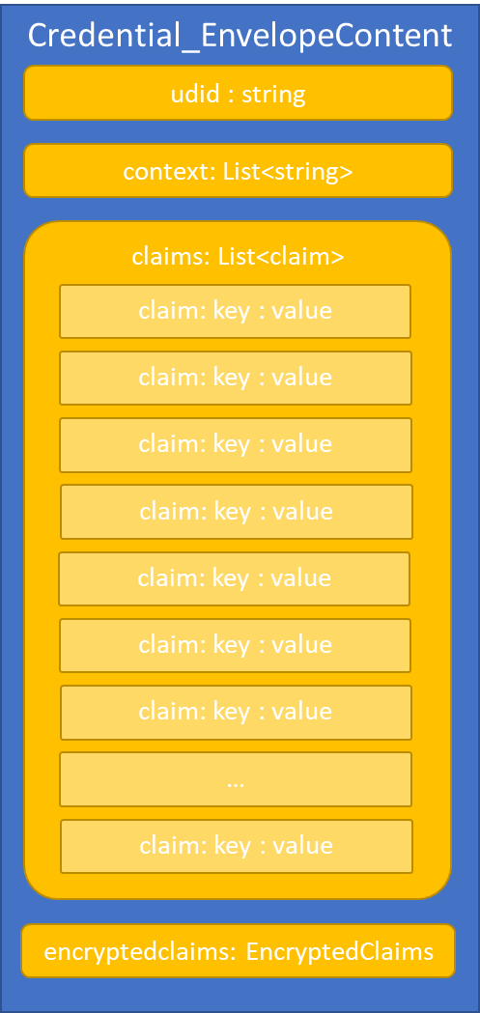
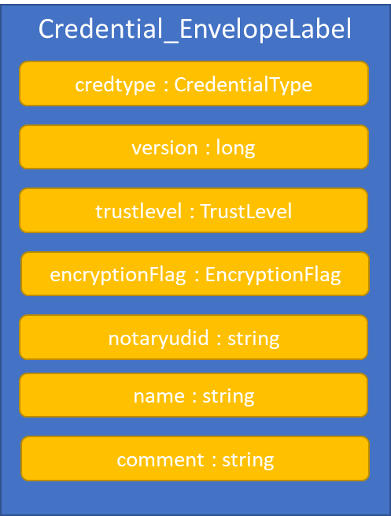

Slide 9
http://greenlight.bcovrin.vonx.io/browse/domain
Record: DOMAIN #1
Type: NYM
Nym: V4SGRU86Z58d6TV7PBUe6f
Role: TRUSTEE
Verkey: ~CoRER63DVYnWZtK8uAzNbx
Record: DOMAIN #6
Transaction ID: 16bf724457da76ec6731e726bfd918bd66d9917e6d4275020807f0ce558efe68
Transaction time: 9/20/2019, 4:03:41 PM (1569017021)
Signed by: V4SGRU86Z58d6TV7PBUe6f
From: V4SGRU86Z58d6TV7PBUe6f
Request ID: 1569017021545721000
Digest: e3b4f467aa386799a69718b5ff2d414efd0a4aa318d2a02e6139ff9e965da051
Type: NYM
Nym: 2MQ7ig94ob5f88eENJ9Bw1
Role: ENDORSER
Verkey: jjLJ9p3VUqiqquhMjBzDWDSdjLTwezcPHm7ggqD8ABW
Record: DOMAIN #2
From: V4SGRU86Z58d6TV7PBUe6f
Type: NYM
Nym: Th7MpTaRZVRYnPiabds81Y
Role: STEWARD
Verkey: ~7TYfekw4GUagBnBVCqPjiC
Record: DOMAIN #7
Transaction ID: 8087a43fd840c49285918f48d290c0004b34c68d257c0da23f42665d1f2dc5b3
Transaction time: 9/20/2019, 4:05:19 PM (1569017119)
Signed by: V4SGRU86Z58d6TV7PBUe6f
From: V4SGRU86Z58d6TV7PBUe6f
Request ID: 1569017119048148000
Digest: 4f1415376f08e13a4d56ac8fe9100557f72ae1b5b6176b5daaab1ed7c07114ec
Type: NYM
Nym: 6qnvgJtqwK44D8LFYnV5Yf
Role: ENDORSER
Verkey: 4Best9vkZjJ4wY6ZpgUcNQvRyXmSqYQYzdqvTjvR8Boc
Record: DOMAIN #3
From: V4SGRU86Z58d6TV7PBUe6f
Type: NYM
Nym: EbP4aYNeTHL6q385GuVpRV
Role: STEWARD
Verkey: ~RHGNtfvkgPEUQzQNtNxLN
Record: DOMAIN #4
From: V4SGRU86Z58d6TV7PBUe6f
Type: NYM
Nym: 4cU41vWW82ArfxJxHkzXPG
Role: STEWARD
Verkey: ~EMoPA6HrpiExVihsVfxD3H
Record: DOMAIN #5
From: V4SGRU86Z58d6TV7PBUe6f
Type: NYM
Nym: TWwCRQRZ2ZHMJFn9TzLp7W
Role: STEWARD
Verkey: ~UhP7K35SAXbix1kCQV4Upx
Record: DOMAIN #8
Transaction ID: 6qnvgJtqwK44D8LFYnV5Yf:1:b6bf7bc8d96f3ea9d132c83b3da8e7760e420138485657372db4d6a981d3fd9e
Transaction time: 9/20/2019, 4:05:20 PM (1569017120)
Signed by: 6qnvgJtqwK44D8LFYnV5Yf
From: 6qnvgJtqwK44D8LFYnV5Yf
Request ID: 1569017119318549800
Digest: bb9fd775f102dd8fd1eb009b225394c524f2684ca4751188b8ace254e89f2321
Type: ATTRIB
Nym: 6qnvgJtqwK44D8LFYnV5Yf
Attribute data: {"endpoint":{"endpoint":"https://bc-registries-greenlight.pathfinder.gov.bc.ca/bcreg"}}

Slide 10
http://greenlight.bcovrin.vonx.io/browse/domain
Record: DOMAIN #1
Type: NYM
Nym: V4SGRU86Z58d6TV7PBUe6f
Role: TRUSTEE
Verkey: ~CoRER63DVYnWZtK8uAzNbx
Record: DOMAIN #6
Transaction ID: 16bf724457da76ec6731e726bfd918bd66d9917e6d4275020807f0ce558efe68
Transaction time: 9/20/2019, 4:03:41 PM (1569017021)
Signed by: V4SGRU86Z58d6TV7PBUe6f
From: V4SGRU86Z58d6TV7PBUe6f
Request ID: 1569017021545721000
Digest: e3b4f467aa386799a69718b5ff2d414efd0a4aa318d2a02e6139ff9e965da051
Type: NYM
Nym: 2MQ7ig94ob5f88eENJ9Bw1
Role: ENDORSER
Verkey: jjLJ9p3VUqiqquhMjBzDWDSdjLTwezcPHm7ggqD8ABW
Record: DOMAIN #7
Transaction ID: 8087a43fd840c49285918f48d290c0004b34c68d257c0da23f42665d1f2dc5b3
Transaction time: 9/20/2019, 4:05:19 PM (1569017119)
Signed by: V4SGRU86Z58d6TV7PBUe6f
From: V4SGRU86Z58d6TV7PBUe6f
Request ID: 1569017119048148000
Digest: 4f1415376f08e13a4d56ac8fe9100557f72ae1b5b6176b5daaab1ed7c07114ec
Type: NYM
Nym: 6qnvgJtqwK44D8LFYnV5Yf
Role: ENDORSER
Verkey: 4Best9vkZjJ4wY6ZpgUcNQvRyXmSqYQYzdqvTjvR8Boc
Record: DOMAIN #8
Transaction ID: 6qnvgJtqwK44D8LFYnV5Yf:1:b6bf7bc8d96f3ea9d132c83b3da8e7760e420138485657372db4d6a981d3fd9e
Transaction time: 9/20/2019, 4:05:20 PM (1569017120)
Signed by: 6qnvgJtqwK44D8LFYnV5Yf
From: 6qnvgJtqwK44D8LFYnV5Yf
Request ID: 1569017119318549800
Digest: bb9fd775f102dd8fd1eb009b225394c524f2684ca4751188b8ace254e89f2321
Type: ATTRIB
Nym: 6qnvgJtqwK44D8LFYnV5Yf
Attribute data: {"endpoint":{"endpoint":"https://bc-registries-greenlight.pathfinder.gov.bc.ca/bcreg"}}
Record: DOMAIN #9
Transaction ID: 6qnvgJtqwK44D8LFYnV5Yf:2:Registered Corporation:1.0.3
Transaction time: 9/20/2019, 4:05:21 PM (1569017121)
Signed by: 6qnvgJtqwK44D8LFYnV5Yf
From: 6qnvgJtqwK44D8LFYnV5Yf
Request ID: 1569017120773332200
Digest: 21d4757706d8a7b7b816e58257aebfef27c49a3eb083070ba099ab10531bef36
Type: SCHEMA
Schema name: Registered Corporation
Schema version: 1.0.3
Schema attributes:
entity_name_effective
city
entity_status_effective
country
address_line_2
address_line_1
entity_type
registration_date
entity_status
corp_num
addressee
province
legal_name
postal_code

Slide 11
http://greenlight.bcovrin.vonx.io/browse/pool
Record: DOMAIN #1
Type: NYM
Nym: V4SGRU86Z58d6TV7PBUe6f
Role: TRUSTEE
Verkey: ~CoRER63DVYnWZtK8uAzNbx
Record: POOL #1
Transaction ID: fea82e10e894419fe2bea7d96296a6d46f50f93f9eeda954ec461b2ed2950b62
From: Th7MpTaRZVRYnPiabds81Y
Type: NODE
Alias: Node1
Nym: Gw6pDLhcBcoQesN72qfotTgFa7cbuqZpkX3Xo6pLhPhv
Client IP: 138.197.161.221
Client port: 9702
Node IP: 138.197.161.221
Node port: 9701
Services: VALIDATOR
Record: DOMAIN #2
From: V4SGRU86Z58d6TV7PBUe6f
Type: NYM
Nym: Th7MpTaRZVRYnPiabds81Y
Role: STEWARD
Verkey: ~7TYfekw4GUagBnBVCqPjiC
Record: POOL #2
Transaction ID: 1ac8aece2a18ced660fef8694b61aac3af08ba875ce3026a160acbc3a3af35fc
From: EbP4aYNeTHL6q385GuVpRV
Type: NODE
Alias: Node2
Nym: 8ECVSk179mjsjKRLWiQtssMLgp6EPhWXtaYyStWPSGAb
Client IP: 138.197.161.221
Client port: 9704
Node IP: 138.197.161.221
Node port: 9703
Services: VALIDATOR
Record: DOMAIN #3
From: V4SGRU86Z58d6TV7PBUe6f
Type: NYM
Nym: EbP4aYNeTHL6q385GuVpRV
Role: STEWARD
Verkey: ~RHGNtfvkgPEUQzQNtNxLN
Record: POOL #3
Transaction ID: 7e9f355dffa78ed24668f0e0e369fd8c224076571c51e2ea8be5f26479edebe4
From: 4cU41vWW82ArfxJxHkzXPG
Type: NODE
Alias: Node3
Nym: DKVxG2fXXTU8yT5N7hGEbXB3dfdAnYv1JczDUHpmDxya
Client IP: 138.197.161.221
Client port: 9706
Node IP: 138.197.161.221
Node port: 9705
Services: VALIDATOR
Record: DOMAIN #4
From: V4SGRU86Z58d6TV7PBUe6f
Type: NYM
Nym: 4cU41vWW82ArfxJxHkzXPG
Role: STEWARD
Verkey: ~EMoPA6HrpiExVihsVfxD3H
Record: POOL #4
Transaction ID: aa5e817d7cc626170eca175822029339a444eb0ee8f0bd20d3b0b76e566fb008
From: TWwCRQRZ2ZHMJFn9TzLp7W
Type: NODE
Alias: Node4
Nym: 4PS3EDQ3dW1tci1Bp6543CfuuebjFrg36kLAUcskGfaA
Client IP: 138.197.161.221
Client port: 9708
Node IP: 138.197.161.221
Node port: 9707
Services: VALIDATOR
Record: DOMAIN #5
From: V4SGRU86Z58d6TV7PBUe6f
Type: NYM
Nym: TWwCRQRZ2ZHMJFn9TzLp7W
Role: STEWARD
Verkey: ~UhP7K35SAXbix1kCQV4Upx

Slide 12


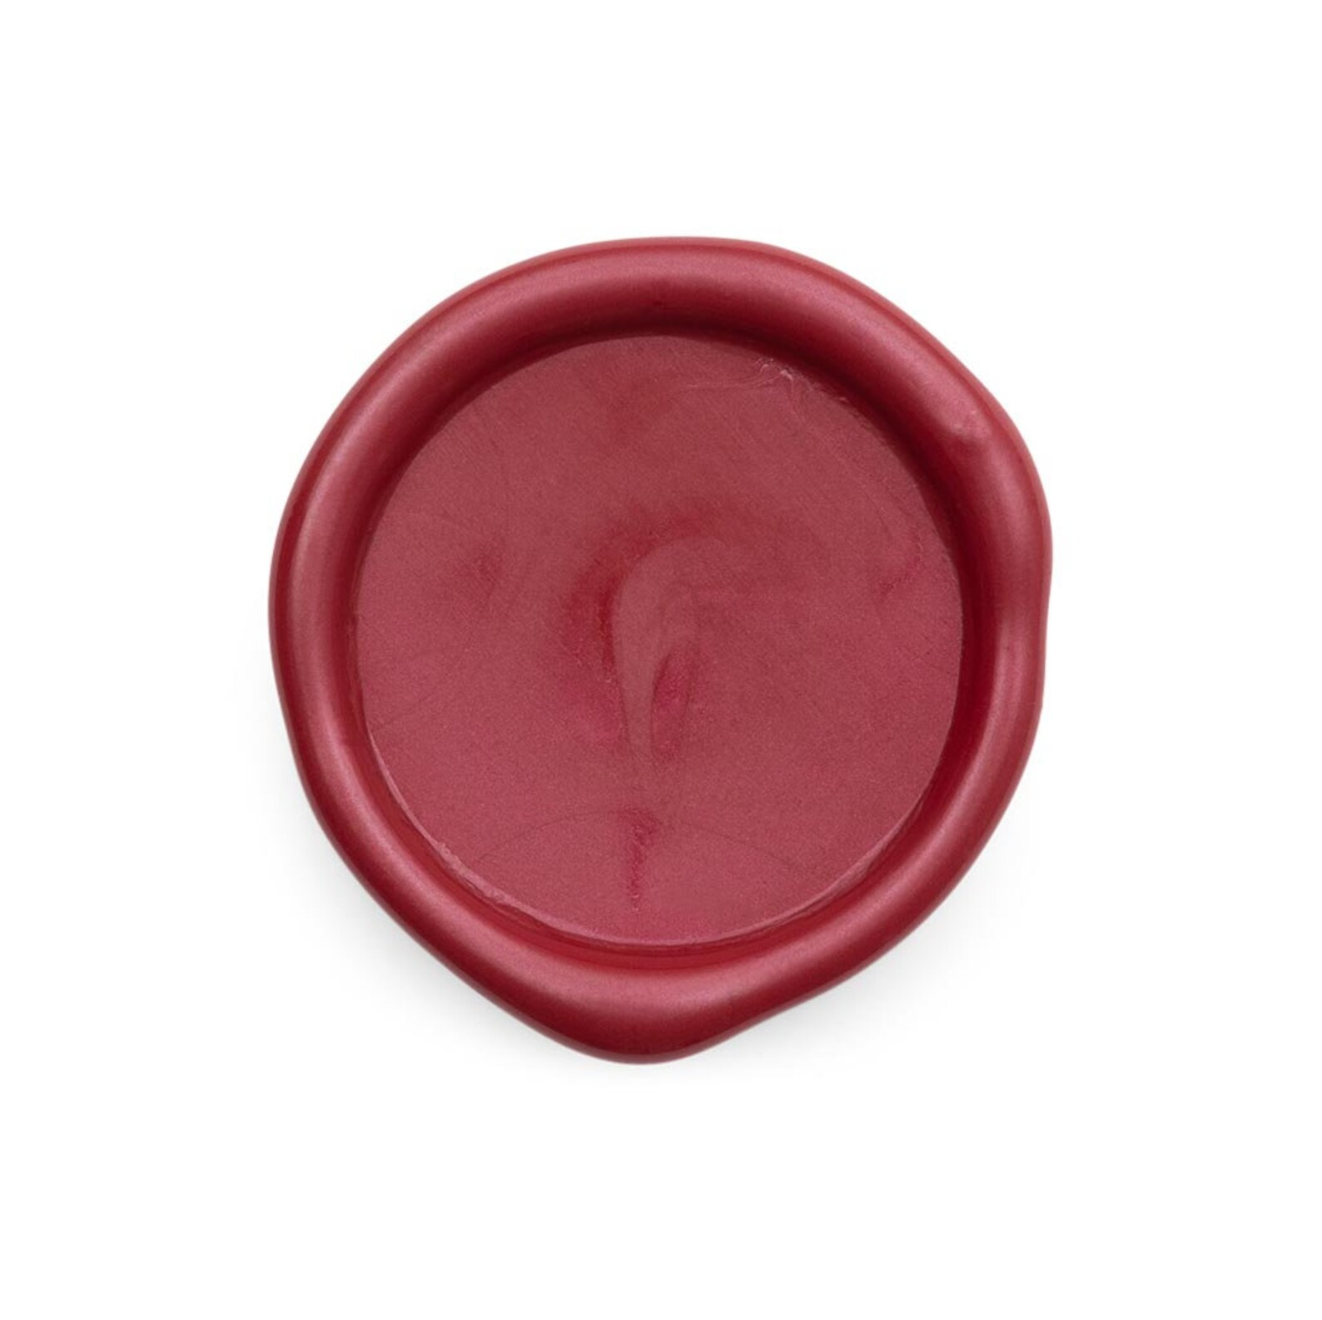

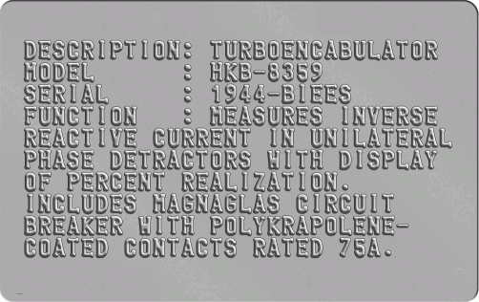
What is a Structured Credential?

Slide 13

Credential Envelope

Slide 14
Credential Envelope
Envelope Content

Slide 15
Credential Envelope
Envelope Content
Packing
Label

Slide 17
Credential
Envelope

Slide 18
Credential
Envelope
Packing
Label

Slide 19
Credential
Envelope
Envelope
Seal
Packing
Label

